Slide 1
INTERNET OF THINGS

Slide 2
Definition
The project involves integrating IoT sensors into public transportation vehicles to monitor ridership, track locations, and predict arrival times.
The goal is to provide real-time transit information to the public through a public platform, enhancing the efficiency and quality of public transportation services.
This project includes defining objectives, designing the IoT sensor system, developing the real-time transit information platform, and integrating them using IoT technology and Python.

Slide 3
Design Thinking
Project Objectives: Define objectives such as real-time transit information, arrival time prediction, ridership monitoring, and enhanced public transportation services.
IoT Sensor Design: Plan the deployment of IoT sensors (e.g., GPS, passenger counters) in public transportation vehicles.
Real-Time Transit Information Platform: Design a web-based platform to display realtime transit information to passengers
Integration Approach: Determine how IoT sensors will send data to the real-time transit information platform.

Slide 4
machine learning algorithms to improve arrival time prediction accuracy based on historical data and traffic conditions.
Due to the advancement of technology machine learning concepts are used in traffic forecasting. This proposed model uses four types of machine learning concepts like DAN(Deep Autoencoder), DBN(Deep Belief Network), RF(Random Forest), and LSTM (Long Short Term Memory).
Introduction
In transportation means, congestion is defined as the excess of vehicles on the roads within a particular time which results in the slower speeds of vehicles comparing with the normal situation. The word congestion refers to the meaning of stopped or stop-and-go traffic. Work zones are the construction which is made on the roadway side that makes physical changes for the particular environment. These work zones also include the less width or number if travel plans, absence of shoulders, diversions, and temporary roads. Then the weather is considered as the most important reason for traffic congestion. The weather conditions which affect the traffic are as follows, bright, sunlight, fog, wet, snowy, icy roadway after the precipitation state.

Slide 5
Deep Belife Network (DBF)
A deep autoencoder is an algorithm that is composed of symmetrical deep networks that have four or five shallow layers mentioning the encoding half of the net and the second set of five or four layers which makes the decoding half.
Deep autoencoders have the ability for minimizing images into 30 number vectors. This autoencoder is a neural network model that seeks to study a compressed representation of the input.
Autoencoder is the unsupervised method of learning. However technically, they are

Slide 6
Random Forest(RF)
RF is one of the easiest and flexible machine learning techniques to produces a better result.
Due to the simplicity, it is used by many people. The following Fig. 2 shows the normal process flow of the DF technique (H. Jiang et al.,).
RF forest technique was initially introduced by Leo Breiman.
This technique use number of training data to improve the variation among the classification system, thus increase the abstraction capability and forecasting capability of the technique.

Slide 7
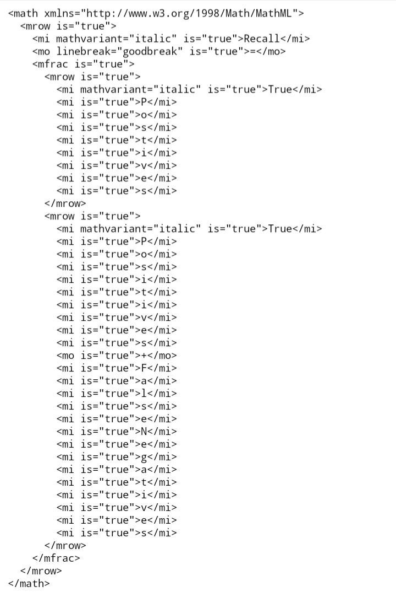
The performace of the proposed system is assesed by using accuracy, MSE(Mean Squared Error), RMSE(Root Mean Square Error), precision and recall. The Eqs. (13), (14), (15), (16), (17) are used to calculate the metrics value of proposed system.

Slide 8


Slide 9
Conclusion
The efficiency of the traffic prediction system is measured by the accuracy of the prediction result.
The main intention of this current research work is to develop a traffic prediction system using machine learning techniques.
Here the system developed by using DAN, DBN, RF, and LSTM techniques. F
inally, the performance of the system can be evaluated in terms of accuracy, precision, recall, RMSE, and MSE metrics. Among the four techniques, LSTM yields a better accuracy level. This system is

Slide 10
INTRODUCTION
IoT can offer many advantages for logistics and transportation in the supply chain, such as visibility of real-time tracking, plus monitoring of the condition and status of shipments, vehicles, and other assets. This can help avoid delays, losses, damages, and thefts. Additionally, IoT can enable smart routing, scheduling, and dispatching for vehicles and drivers based on traffic, weather, and demand patterns. This can optimize fuel consumption, reduce idle time, and increase productivity and utilization. IoT can also ensure product quality and safety by measuring and controlling a shipment's temperature, humidity, pressure, and vibration. This can help comply with regulations, reduce waste, and improve customer satisfaction. And IoT can reduce environmental impact by lowering carbon emissions, fuel consumption, and noise pollution. This can help meet corporate social responsibility goals while enhancing reputation and saving costs.

Slide 11
Benefits of IoT for logistics and transportation
IoT can present certain challenges in the supply chain, such as security, integration, and regulation. You must implement security measures like encryption, authentication, and firewalls to protect IoT networks and data. Also, it is important to guarantee IoT solution compatibility, interoperability, and scalability to avoid vendor lock-in and siloed data. And take account of legal and ethical issues when collecting, processing, or sharing large amounts of data. It is important to comply with relevant laws and regulations, such as GDPR, and respect the rights and preferences of customers, partners, and stakeholders.

Slide 12
Challenges of IoT for logistics and transportation
To leverage the benefits and overcome the challenges of IoT, adhere to certain best practices. Start by defining your goals and metrics so you can align your IoT strategy with your business strategy and measure the ROI. Then, select the most suitable IoT devices, sensors, platforms, and applications for your needs, taking into consideration their reliability, cost, and maintenance. Test your solutions before deploying them widely to evaluate their functionality, usability, and security. Also educate your staff on how to use and benefit from your IoT solutions. Provide them with the necessary skills and tools to address any concerns. Finally, foster a culture of innovation and collaboration so staff can share their feedback.

Slide 13
Best practices for IoT for logistics and transportation
To leverage the benefits and overcome the challenges of IoT, adhere to certain best practices. Start by defining your goals and metrics so you can align your IoT strategy with your business strategy and measure the ROI. Then, select the most suitable IoT devices, sensors, platforms, and applications for your needs, taking into consideration their reliability, cost, and maintenance. Test your solutions before deploying them widely to evaluate their functionality, usability, and security. Also educate your staff on how to use and benefit from your IoT solutions. Provide them with the necessary skills and tools to address any concerns. Finally, foster a culture of innovation and collaboration so staff can share their feedback.

Slide 14
Examples
IoT has many ways to optimize logistics and transportation. For instance, you can equip smart containers with sensors that monitor the location, condition, and status of goods. This data is sent to a cloud-based platform which provides real-time visibility and alerts to shippers, carriers, and customers. Additionally, smart containers enable smart locking and unlocking, and automate the documentation and customs clearance processes. Smart fleet management is another example. IoT devices and platforms can manage vehicles and drivers in a fleet by collecting data on vehicle speed, location, fuel level, mileage, maintenance, and driving behavior. Smart routing, scheduling, and dispatching of the vehicles and drivers are also possible based on traffic, weather, and demand patterns. Lastly, smart warehouses use IoT devices to automate and optimize the storage, handling, and distribution of goods. RFID tags, barcode scanners, drones, robots, and smart shelves are able to track inventory while smart lighting systems help reduce energy costs.

Slide 15
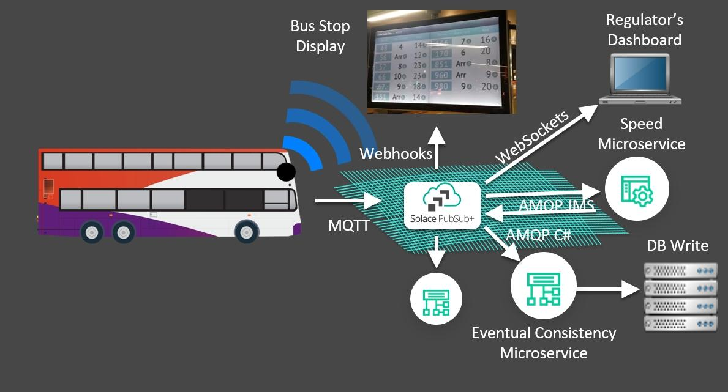
IOT IN TRANSPORTATION

Slide 16
INTERNET OF THINGS
Submitted by ,
Name:V.Kanimozhi
Year:III
DEPT:COMPUTING SCIENCE AND ENGINEERING
COLLEGE:UNIVERSITY COLLEGE OF ENGINEERING,TIRUKKUVALAI
PROJECT NAME:
PUBLIC TRANSPORT
OPTIMIZATION

